Slide 1
Contour, A High Performance Multitenant Ingress Controller for Kubernetes

Slide 2






Nick Young
Technical Lead
Staff Engineer, VMware
@youngnick
Steve Sloka
Sr. Member of Technical Staff, VMware
@stevesloka
James Peach
Staff Engineer, VMware
@jpeach
Michael Michael
Product Lead
Director of PM, VMware
@m2
Steve Kriss
Staff Engineer, VMware
@skriss
Tong Liu
Engineering Manager, VMware
@tongl

Slide 3

Contour
Contour is an open source Kubernetes ingress controller providing a control plane for the Envoy edge and service proxy.​ Contour supports dynamic configuration updates and multi-team ingress delegation out of the box while maintaining a lightweight profile.

Slide 4
Highlights
Started in September 2017 at Heptio
Released v1.0 in November 2019
Donated to the CNCF at Incubation level in July 2020
Released v1.10 in November 2020

Slide 5
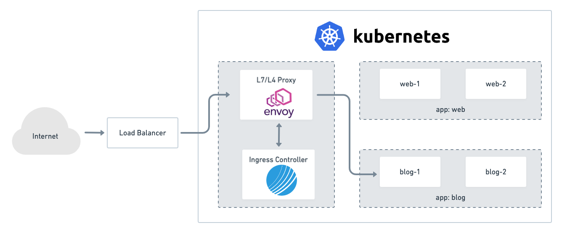
Architecture

Slide 6
What’s New?
External Authorization Support
CORS Support
Envoy xDS v3 Support
Improved Integration Support
Knative Ingress support with net-contour
Contour Operator (Alpha)
Lkl
oiiiiiiiiiiiiiiiiiiiiiiiiiiiiiiiiiiiiiiiiiiiiiiiiiiiiiiiiiiiiiii

Slide 7
External Authorization
One of the earliest user-requested features for Contour
Makes it easy for platform operators to enable authorization across a portfolio of services
Build your own authorization server, or use one from the broader Envoy ecosystem (for example, Istio's authservice https://github.com/istio-ecosystem/authservice)

Slide 8
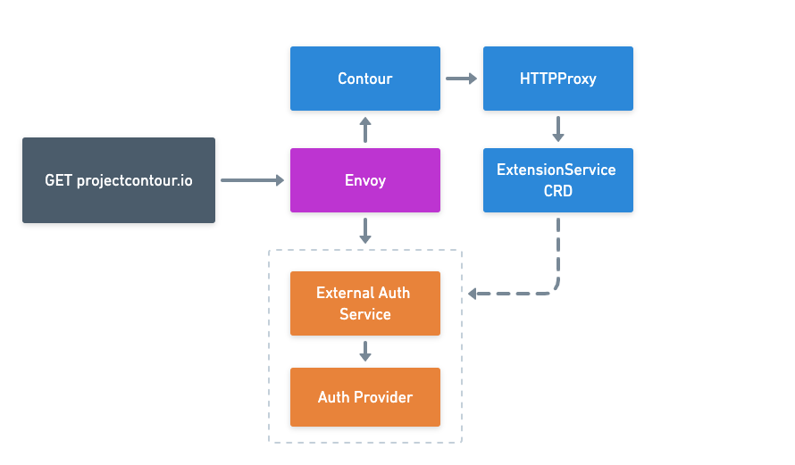
Ext. Auth. Architecture

Slide 9
Demo!

Slide 10
Roadmap
Rate Limiting
LCM/Deployment Support (Helm Chart, Operator)
More Envoy configuration knobs
Service APIs Support
For more details, visit our public Roadmap
Helm
Help

Slide 11






Contour Community
Slack.k8s.io
projectcontour.io
https://projectcontour.io/community/
#contour
cncf-contour-users@lists.cncf.io
2.5k
GitHub Stars
430+ Contributors
400+
Forks
5
Maintainers
55+
Releases
130+
Contributing
Companies
@projectcontour
https://github.com/projectcontour
731
Slack members
14 Blogs
7 KubeCon talks
750+
Twitter followers
https://www.youtube.com/playlist?list=PL7bmigfV0EqTBsPrnCkzhu0R4SAWnBjLj

